Slide 1
Interconnection Networks for Parallel Computers
Interconnection networks carry data between processors and to memory.
Interconnects are made of switches and links (wires, fiber).
Interconnects are classified as static or dynamic.
Static networks consist of point-to-point communication links among processing nodes and are also referred to as direct networks.
Dynamic networks are built using switches and communication links. Dynamic networks are also referred to as indirect networks.

Slide 2
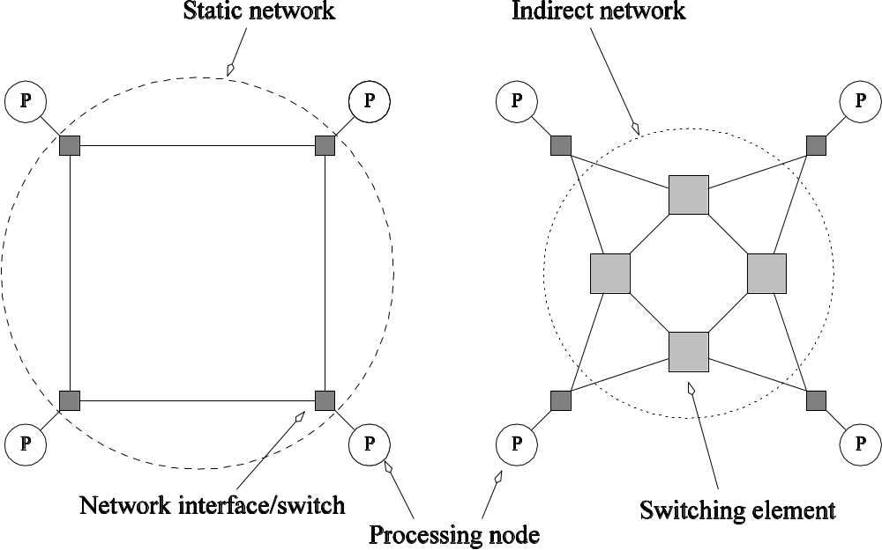
Static and Dynamic
Interconnection Networks
Classification of interconnection networks: (a) a static network; and (b) a dynamic network.

Slide 3
Interconnection Networks
Switches map a fixed number of inputs to outputs.
The total number of ports on a switch is the degree of the switch.
The cost of a switch grows as the square of the degree of the switch, the peripheral hardware linearly as the degree, and the packaging costs linearly as the number of pins.

Slide 4
Interconnection Networks:
Network Interfaces
Processors talk to the network via a network interface.
The network interface may hang off the I/O bus or the memory bus.
In a physical sense, this distinguishes a cluster from a tightly coupled multicomputer.
The relative speeds of the I/O and memory buses impact the performance of the network.

Slide 5
Network Topologies
A variety of network topologies have been proposed and implemented.
These topologies tradeoff performance for cost.
Commercial machines often implement hybrids of multiple topologies for reasons of packaging, cost, and available components.

Slide 6
Network Topologies: Buses
Some of the simplest and earliest parallel machines used buses.
All processors access a common bus for exchanging data.
The distance between any two nodes is O(1) in a bus. The bus also provides a convenient broadcast media.
However, the bandwidth of the shared bus is a major bottleneck.
Typical bus based machines are limited to dozens of nodes. Sun Enterprise servers and Intel Pentium based shared-bus multiprocessors are examples of such architectures.

Slide 7
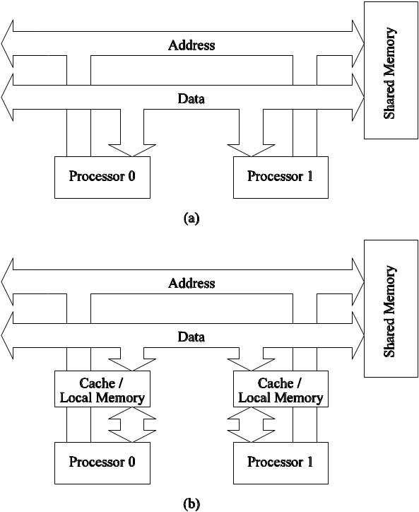
Network Topologies: Buses
Bus-based interconnects (a) with no local caches; (b) with local memory/caches.
Since much of the data accessed by processors is local to the processor, a local memory can improve the performance of bus-based machines.

Slide 8
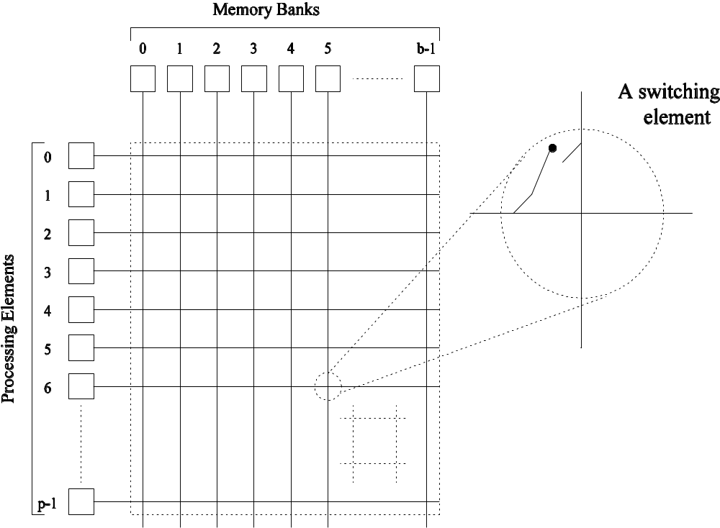
Network Topologies: Crossbars
A crossbar network uses an p×m grid of switches to connect p inputs to m outputs in a non-blocking manner.
A completely non-blocking crossbar network connecting p processors to b memory banks.

Slide 9
Network Topologies: Crossbars
The cost of a crossbar of p processors grows as O(p²).
This is generally difficult to scale for large values of p.
Examples of machines that employ crossbars include the Sun Ultra HPC 10000 and the Fujitsu VPP500.

Slide 10
Message Passing Costs in
Parallel Computers
The total time to transfer a message over a network comprises of the following:
  Startup time (t_{s}): Time spent at sending and receiving nodes (executing the routing algorithm, programming routers, etc.).
  Per-hop time (t_{h}): This time is a function of number of hops and includes factors such as switch latencies, network delays, etc.
  Per-word transfer time (t_{w}): This time includes all overheads that are determined by the length of the message. This includes bandwidth of links, error checking and correction, etc.

